Slide 1
E-learning System
By Preeti Rachel (17bcs0003) and Yaswanth K (17bcs0001)

Slide 2
E learning System ( VES)
In the early days of e-learning, some people were concerned that bringing computers into the classroom would remove the human element that many learners benefit from. But technology has developed, and smart phones and tablets are now widely embraced in both the classroom and office. We also use a wealth of interactive designs that ensure distance learning is both an engaging and valuable lesson delivery medium

Slide 3
MODULES:
HOME
LOGIN
COMPUTER SCIENCE
PHYSICS
CHEMISTRY
STUDENTS

Slide 4
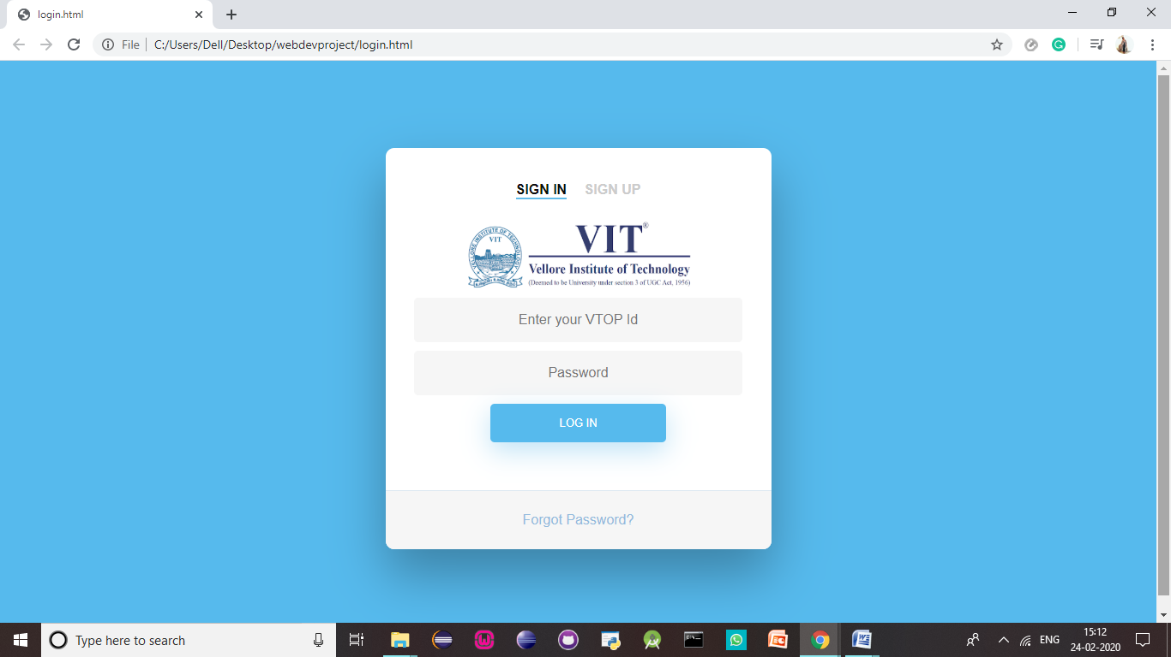
MODULE DESCRIPTION:
LOGIN: Students can login or sign up using their register no and password.

Slide 5
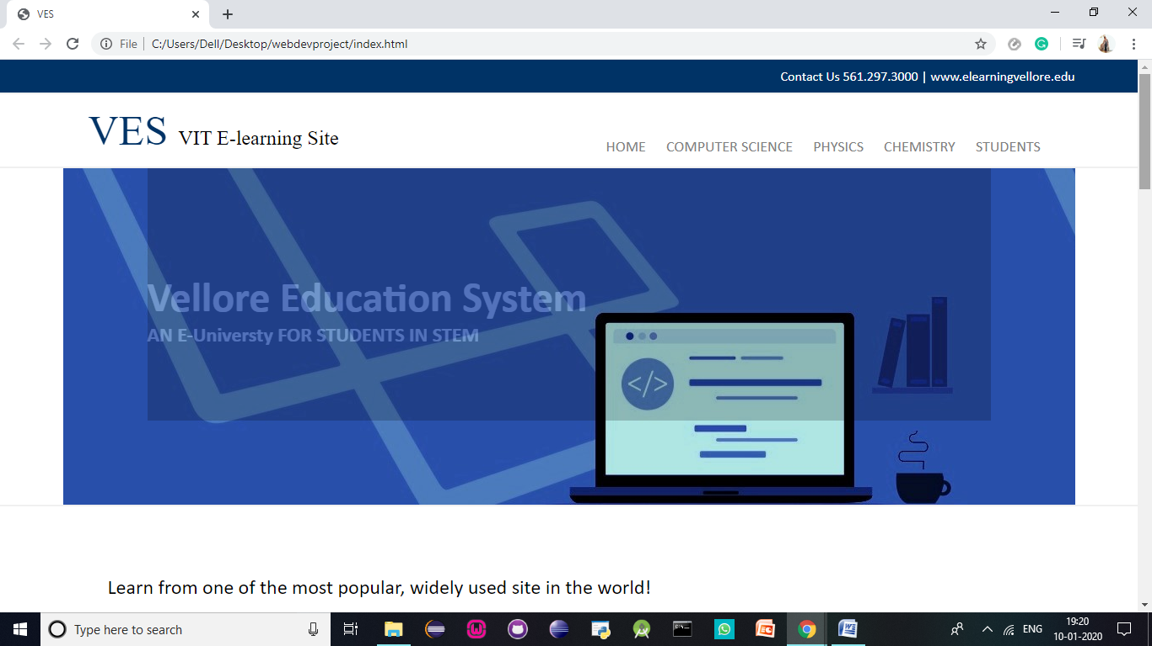
HOME: There is a login page where students can signup or login to the website. the home page describes the importance of the C language and also provides the advantages of learning the language

Slide 6
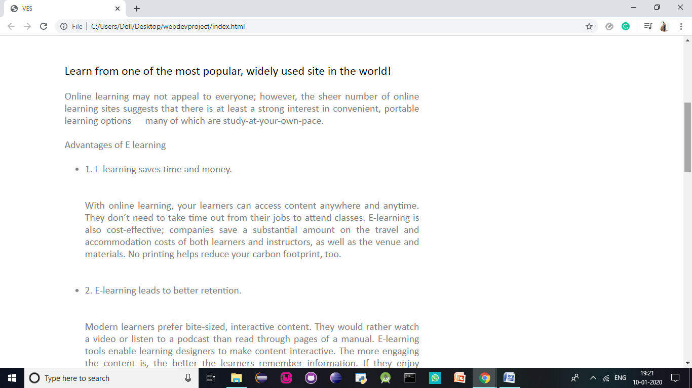
HOME: There is a login page where students can signup or login to the website. the home page describes the importance of the C language and also provides the advantages of learning the language

Slide 7
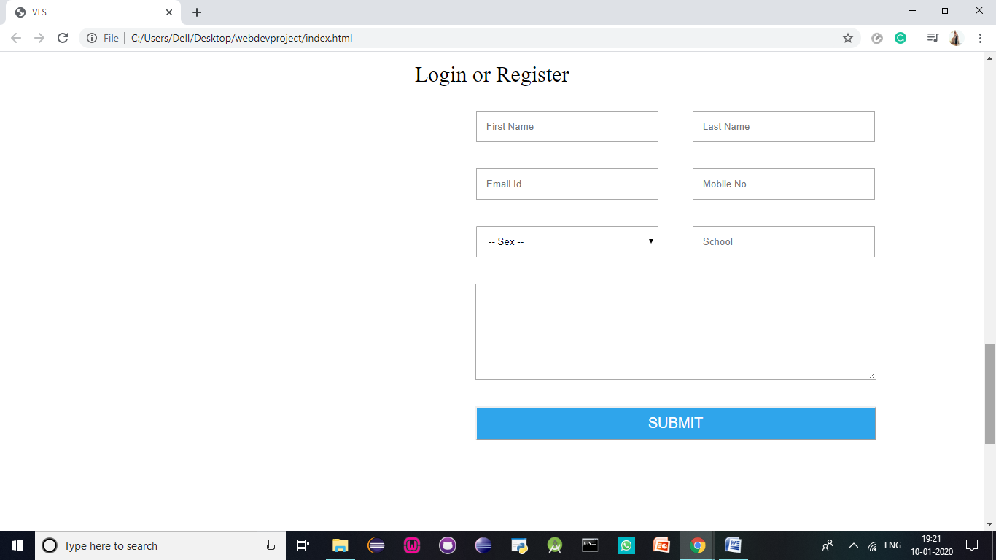
HOME: There is a login page where students can signup or login to the website. the home page describes the importance of the C language and also provides the advantages of learning the language

Slide 8
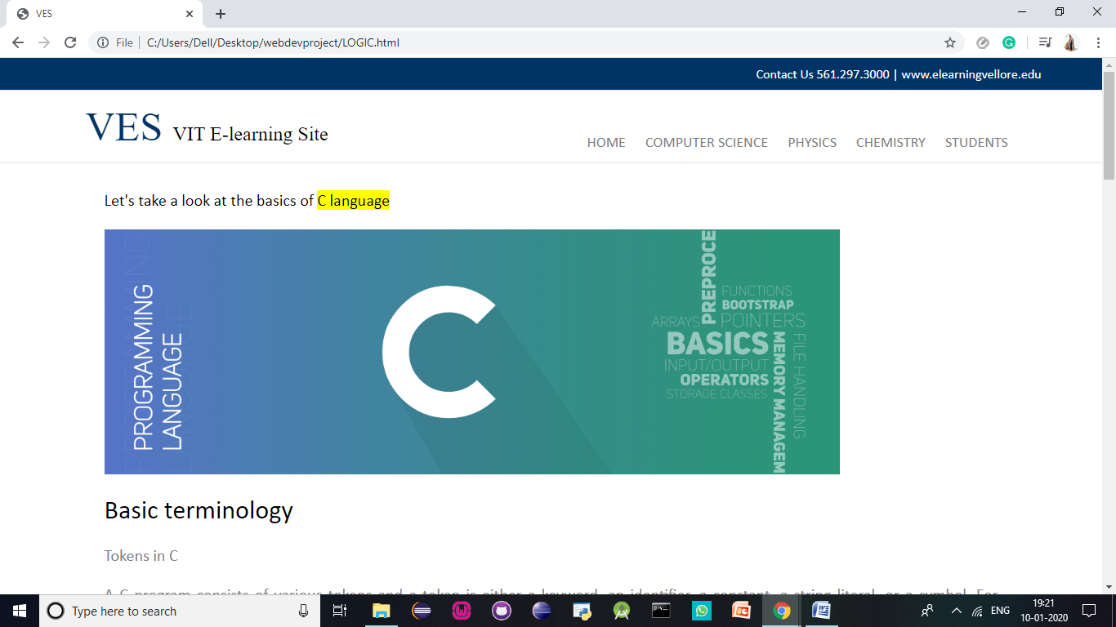
COMPUTER SCIENCE: This page contains the logic of the language and he fundamentals required to start programming.

Slide 9
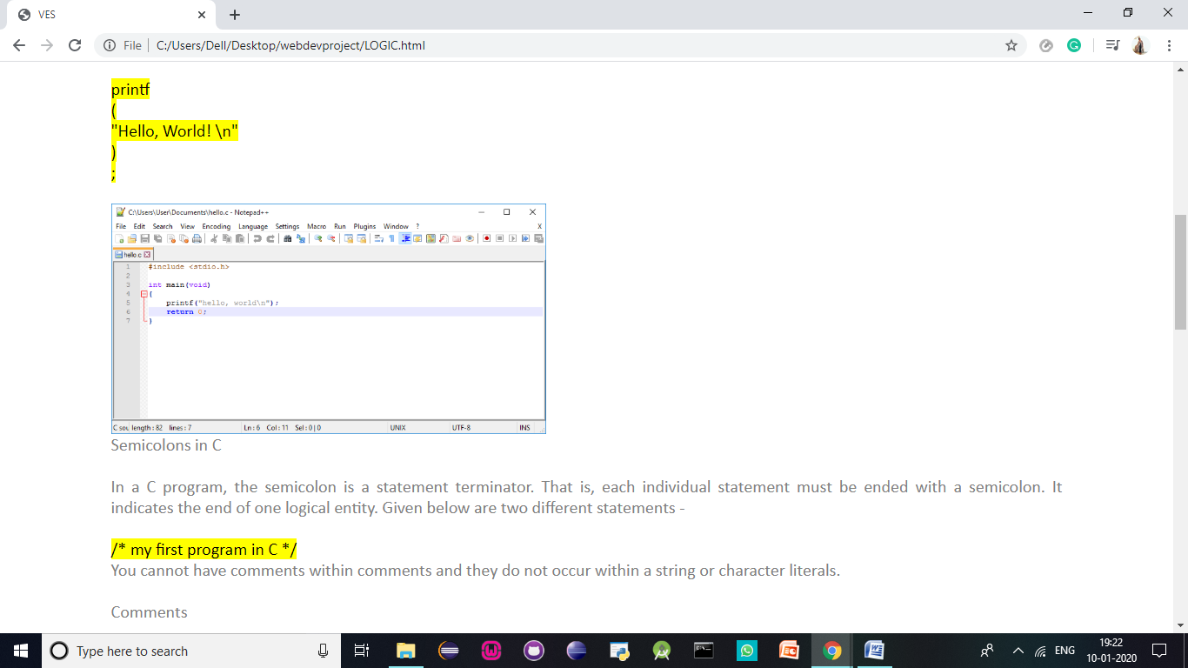
COMPUTER SCIENCE: This page contains the logic of the language and he fundamentals required to start programming.

Slide 10
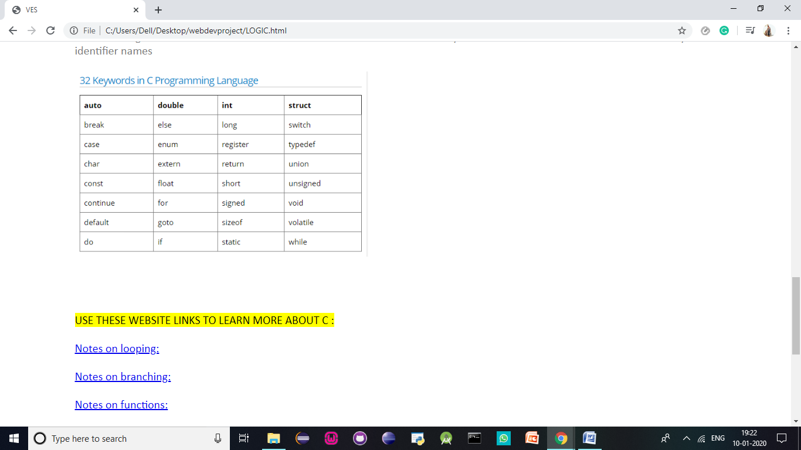
COMPUTER SCIENCE: This page contains the logic of the language and he fundamentals required to start programming.

Slide 11
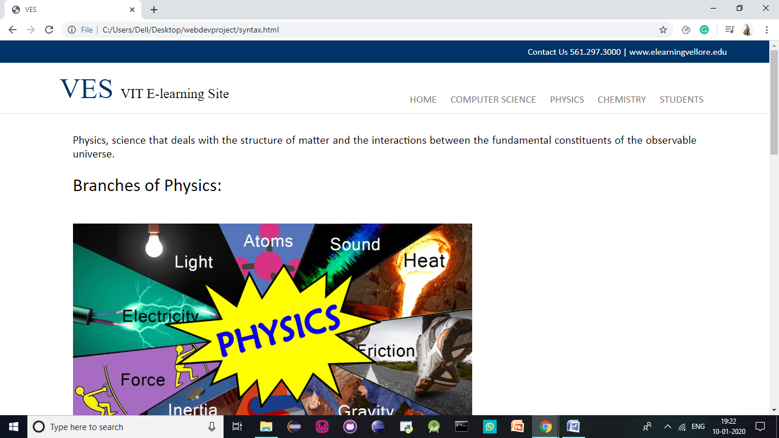
PHYSICS: This page provides the syntax required to start coding. The basic syntax that C language follows must be understood inorder to start coding effectivel

Slide 12
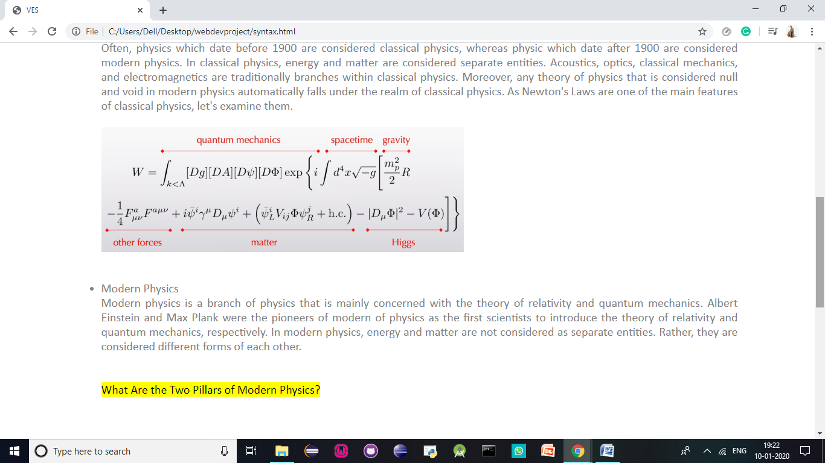
PHYSICS: This page provides the syntax required to start coding. The basic syntax that C language follows must be understood inorder to start coding effectivel

Slide 13
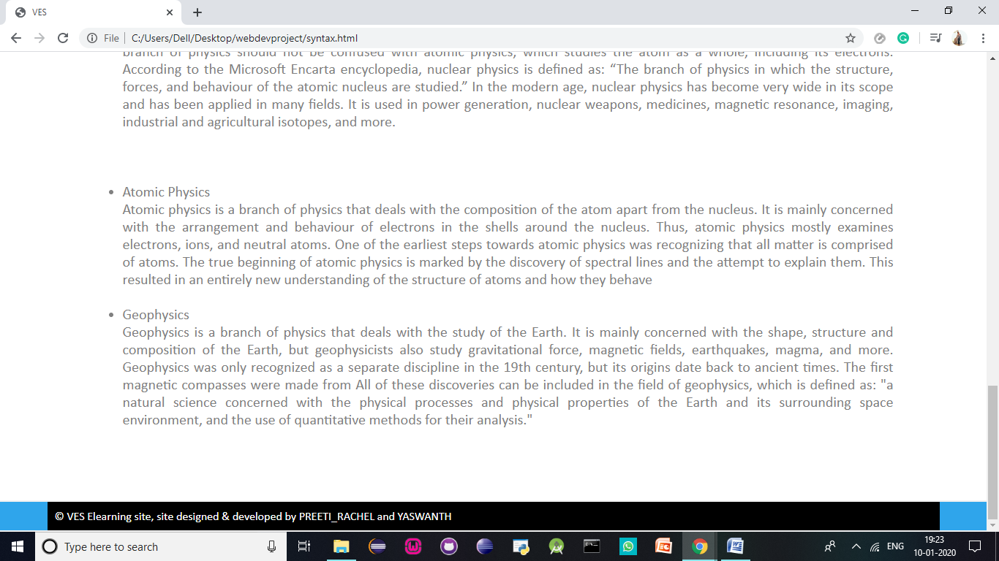
PHYSICS: This page provides the syntax required to start coding. The basic syntax that C language follows must be understood inorder to start coding effectivel

Slide 14
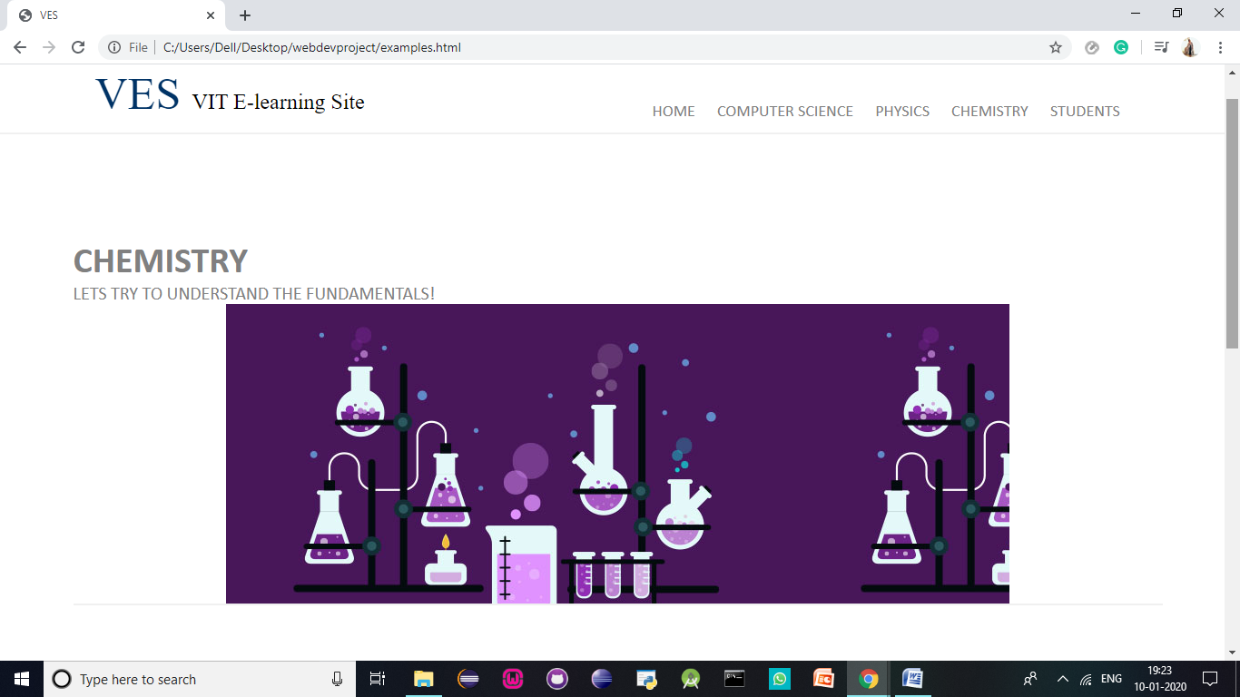
CHEMISTRY: This page provides examples of programs in C language. The programs are fun to do and easy to follow

Slide 15
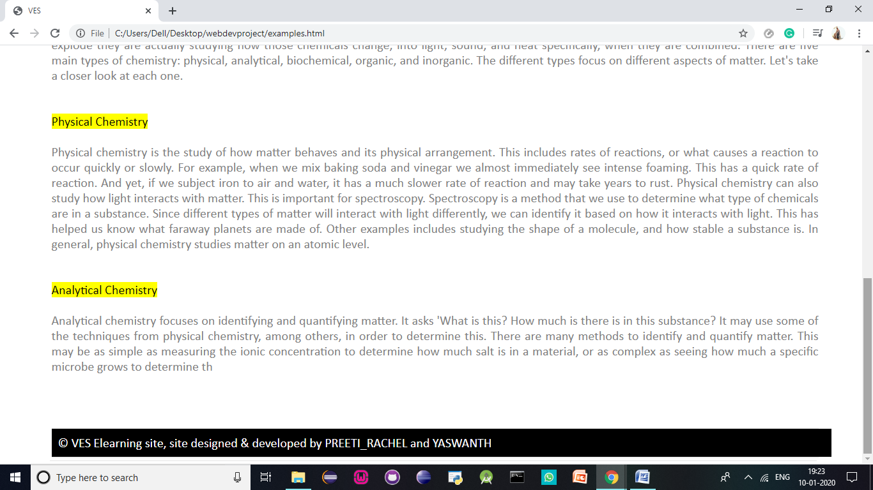
CHEMISTRY: This page provides examples of programs in C language. The programs are fun to do and easy to follow

Slide 16
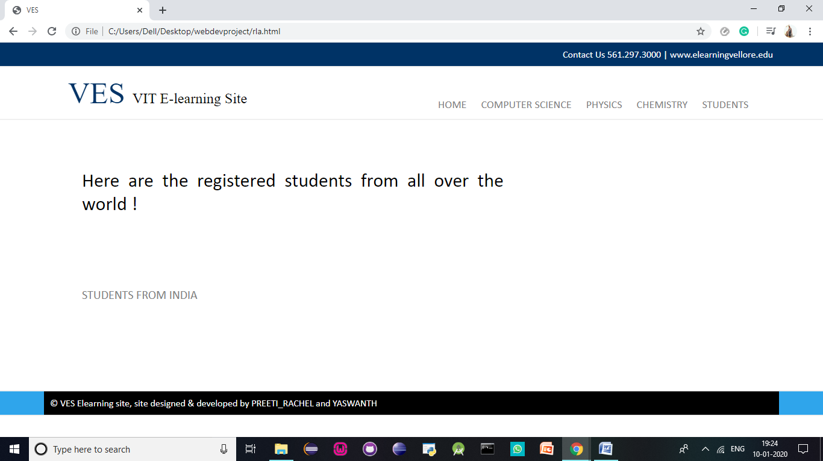
STUDENTS: Students registered will be shown here.

Slide 17
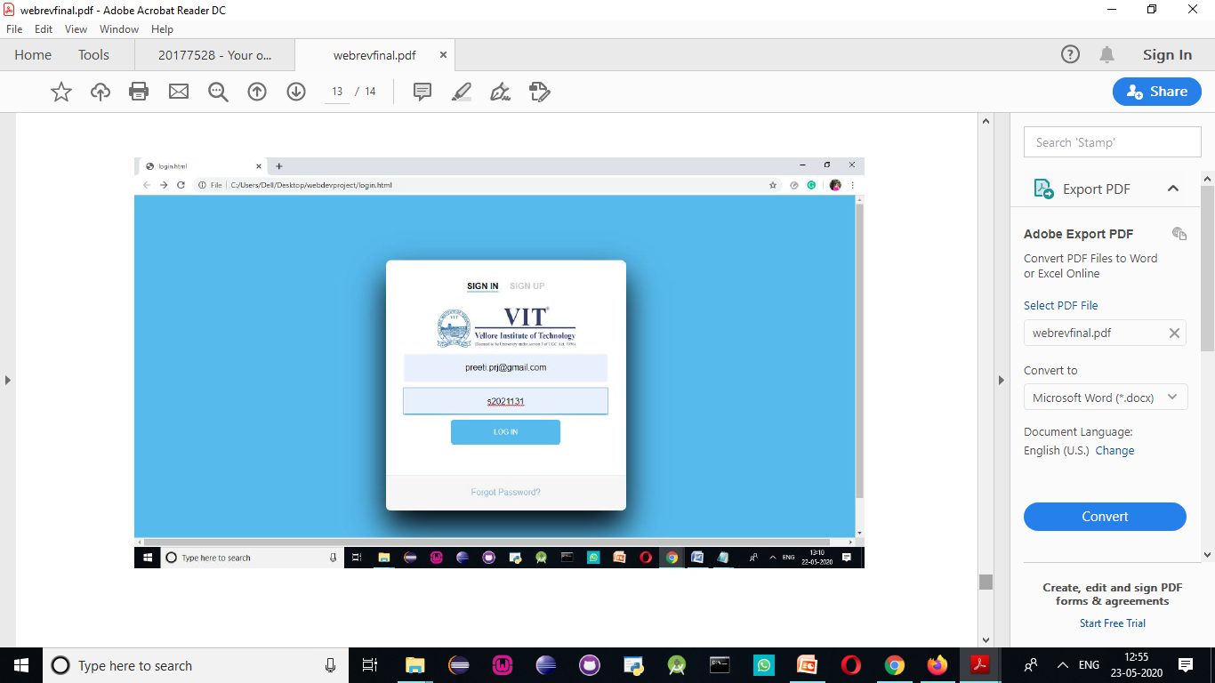
Login JSP: Students registered will be shown here.

Slide 18
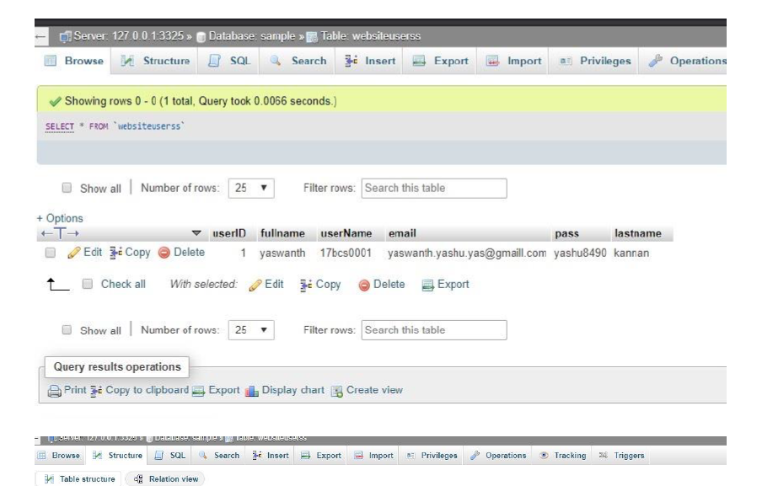
wamp: Students registered will be shown here.

Slide 19
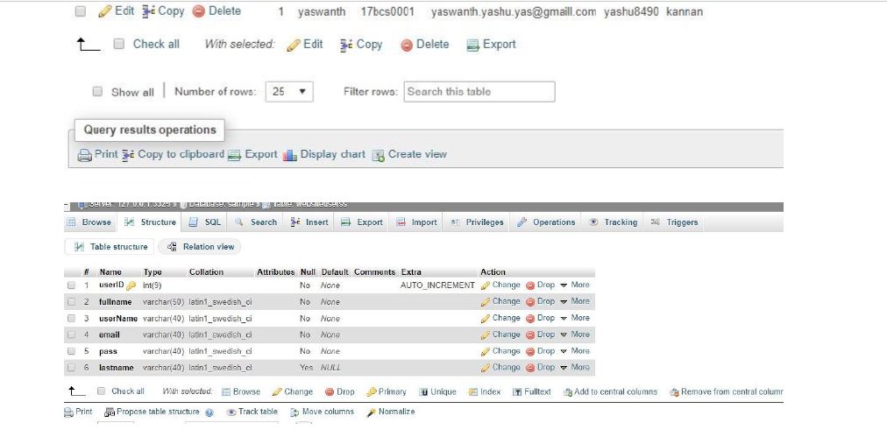
wamp: Students registered will be shown here.

Slide 20
THANK YOU.

